Slide 1
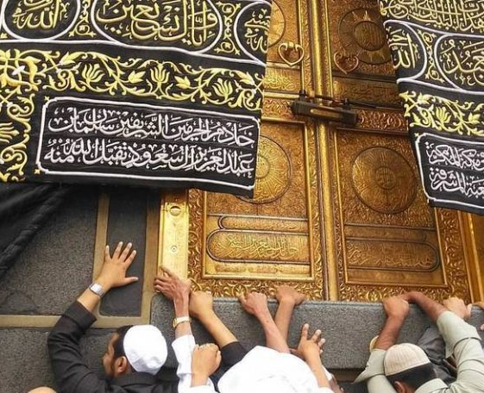

Umrah
Presentation based on the works of Mufti Faraz Mahmudi

Slide 2
State of Ihram
Ihram refers to the state that you must enter prior to going into the sacred precinct of Makkah for Umrah. While you are in this state certain acts become haram - hence the term Ihram (literally, “to make haram.”)
The wearing of the white clothing symbolises this state, although this state is not entered into by wearing the sheets of white alone.
hajjnaseeha.com

Slide 3
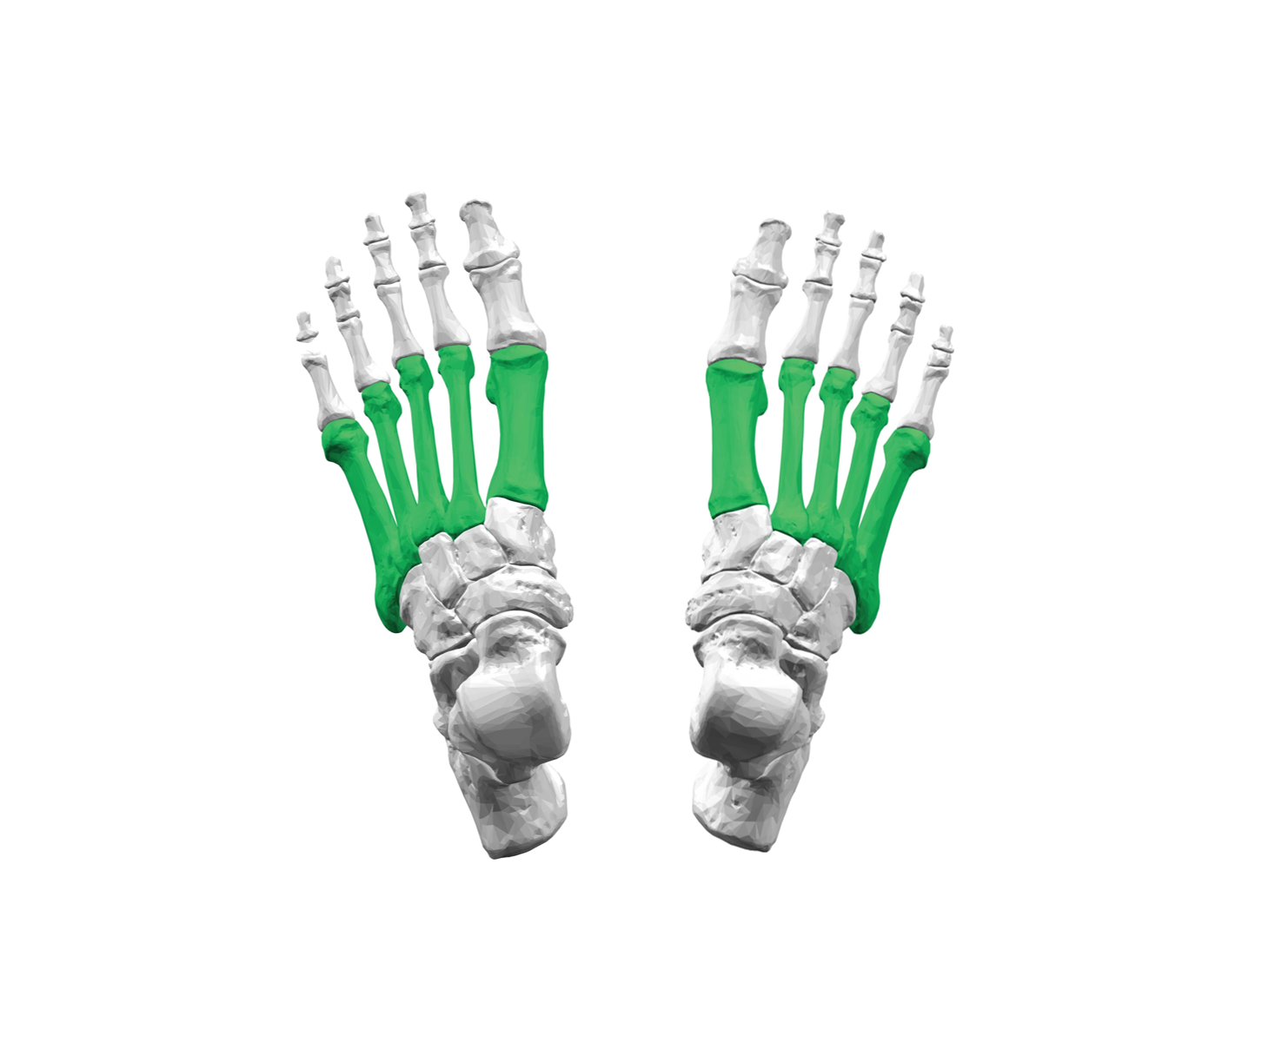
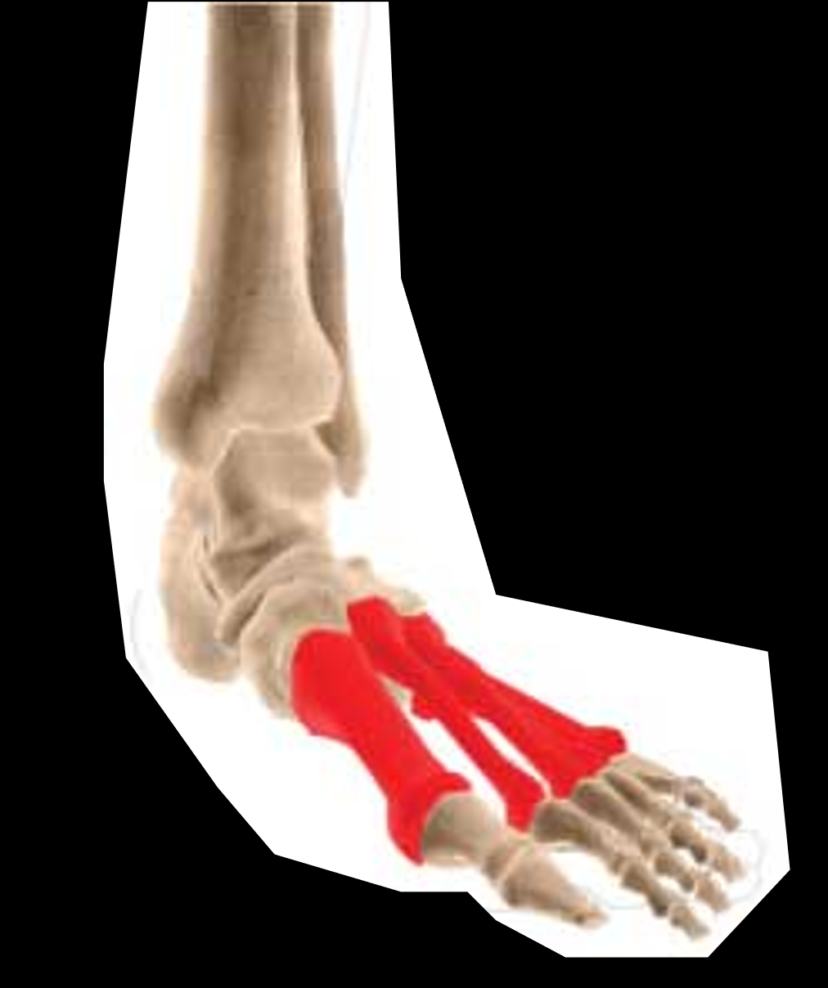
Men’s Ihram
It is preferable to wear two white new or washed sheets of cloth: an upper garment and a lower garment.
Males should wear slippers/sandals which expose the tarsal bone/mid-foot area where there is a protruding bone.
hajjnaseeha.com

Slide 4
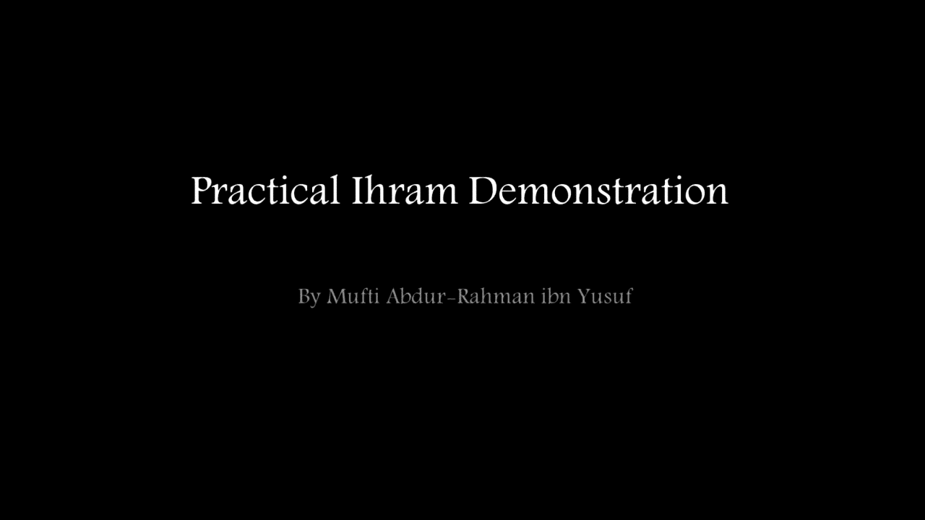

Slide 5
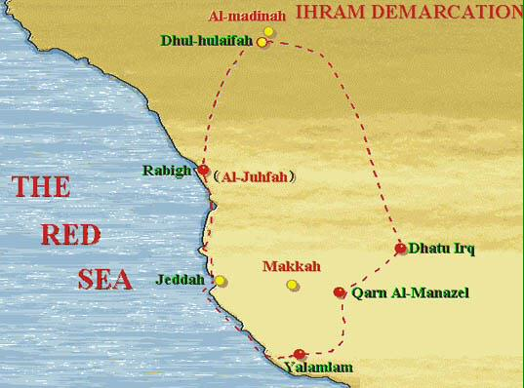
Meeqat
hajjnaseeha.com

Slide 6
Women’s Ihram
Women may wear an abaya, scarf, gloves, socks and shoes.
The face must not have anything touching it physically.
However, she can cover the face with a cap fitted with a veil
hanging over the cap as not to touch the face if she prefers to
hajjnaseeha.com

Slide 7
Prohibitions in Ihram
Sins
Foul language, fighting, quarrelling
All forms of intimacy with one’s spouse
Wearing day to day clothes like Jubbah, shirt, trousers, t-shirts, hats etc. for men
Using perfume and fragrances
Removal of body hair - to comb, pluck, trim or cut the beard hair
Clipping the nails
Wearing footwear covering the shoe-lace area
For a male to cover the head with something touching the head
For a female to let a cloth cover her face in a manner it is touching her face
To hunt or help in hunting
To kill lice
hajjnaseeha.com

Slide 8
Permissibility in Ihram
Having a shower for purification or for coolness
Using unscented soap - However, it is preferable not to remove dirt
Injections
Bandages
To wear sunglasses, glasses or a watch
To change a nappy or diaper
Miswak
It is permissible to wrap yourself in a blanket - The whole body can be covered except the face and head
To wear a belt
To kill scorpions, snakes, mosquitoes, wasps and flies
hajjnaseeha.com

Slide 9
Before coming into Ihram
It is Sunnah to:
take a bath
It is Mustahab (recommended) to:
trim one’s moustache
remove hair from pubic areas
clip nails
apply perfume
hajjnaseeha.com

Slide 10
When to get into Ihram
Meeqat is the boundary before which pilgrims must be in the state of Ihram, otherwise a penalty will be due on them.
This means wearing the Ihram cloths (for men) and making the intention of Umrah.
Practical tips:
Don’t make intention until at least half an hour to one hour before your plane
lands in Jeddah airport.
Keep your Ihram cloths (and sandals etc) in your hand luggage if you intend to wear it at a transit airport or on the plane.
If you go directly from UK to Jeddah, wear the bottom half of the Ihram beforehand and top half on the plane; or wear it all beforehand.
hajjnaseeha.com

Slide 11
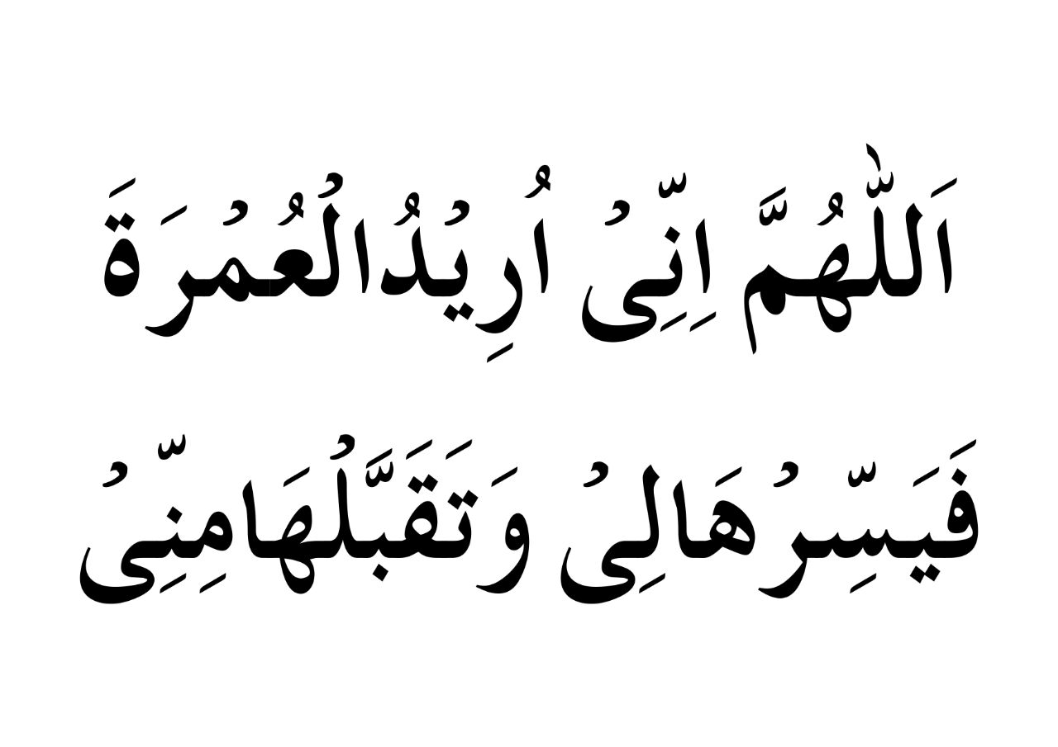
Entering into Ihram
Niyyah + Talbiyah = Ihram
One may recite the following Du’a before reciting the Talbiyah:
“Oh Allah, I make intention for Umrah, make it easy for me and accept it
from me.”
Allahumma Inni Uridhul ‘Umratha, Fayassir Haali Wa-thaqabbalhaa Minni
hajjnaseeha.com

Slide 12
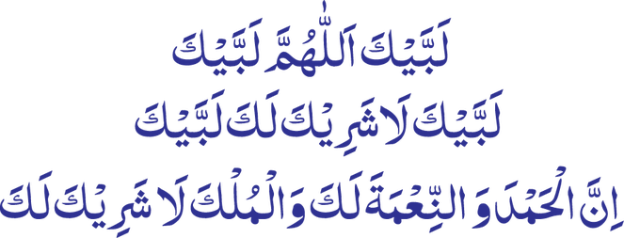
Talbiyah
Talbiyah is the pilgrim’s answer to Allah’s call to Umrah
“Here I am, O Allah, here I am. Here I am, You have no partner, here I am.
Verily all praise and blessings are Yours, and all sovereignty, You have no partner”
Labbayka Allahumma labbayk, labbayka laa shareeka laka labbayk. Inna al-hamda wan-ni’mata laka wal mulk, laa shareeka lak
hajjnaseeha.com

Slide 13
Components of the Umrah
SUNNAH
WAJIB
FARDH
Ghusl for Ihram
2 Rak’ah before
Ihram
2 Rak’ah after Tawaf
Sa’ee
Halaq (shaving)/
Qasr (trimming)
Ihraam with intention and Talbiyah
Tawaf
hajjnaseeha.com

Slide 14
Entering Makkah
The city of Makkah should be entered with humbleness with the heart fully conscious of the grandeur of Almighty Allah.
It is not a sight-seeing trip.
One should be engaged in reciting the Talbiyah all the while.
Practical tips:
It is advisable to rest before performing Umrah.
It may be a wise idea to perform Umrah at night when the heat is less.
Be careful of using scented toiletries and Bakhoor burners in shopping centres etc whilst in Ihram.
hajjnaseeha.com

Slide 15
Performing Umrah: Entering Masjid Al-Haram
Enter with the right foot reading the Du’a and reciting Salawat upon the Prophet ﷺ
Proceed to the Ka’bah not as a tourist but as a servant with utmost humbleness.
Stop and make Du’a. This is a very sacred place and time for the acceptance of Du’a.
Practical tips:
Reach a place where the Ka’bah is clearly visible and which is not obstructing others so you can spend time in making Du’a.
You may be able to see the Ka’bah from King Abdul Aziz Gate, so keep that in mind for when you make your first glance.
hajjnaseeha.com

Slide 16
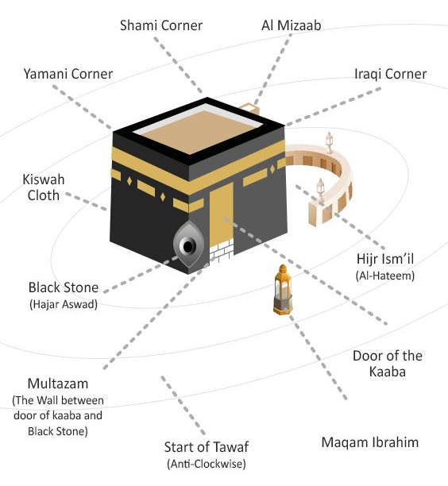
The Ka’bah
hajjnaseeha.com

Slide 17
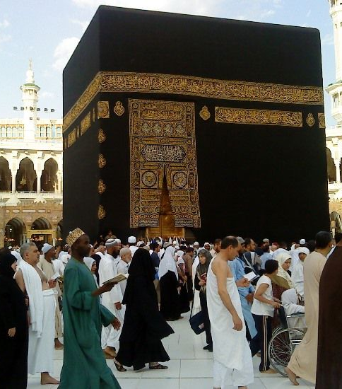
TAWAF

Slide 18
Performing Umrah: Preparing for Tawaf
Tawaf is a compulsory part of Umrah. It is to walk around the Ka'bah seven times.
It is Wajib (necessary) to have Wudhu when performing Tawaf.
To begin Tawaf, one should proceed to the corner of the Ka’bah where the Hajar al-Aswad (Black Stone) is.
The recitation of Talbiyah ends with the commencing of Tawaf.
Practical tips:
Begin on the outer circle of the Mataf and not within the crowd.
Men should keep the right shoulder uncovered for the duration of the Tawaf; prepare this before joining the crowd. This is called Idhtibaa’.
hajjnaseeha.com

Slide 19
Performing Umrah: Tawaf
Step in line with the Black Stone with the body facing it.
Now 2 actions need to be done:
1) Istiqbaal 2) Istilaam
Istiqbaal: to raise one’s hands, like one does in Salah, whilst facing the Black Stone and say:
ألله أكبر لا إله إلا الله
After raising the hands and saying the above, one will put the hands back down to one’s side. This will always be done when one commences any Tawaf.
hajjnaseeha.com

Slide 20
Performing Umrah: Tawaf
Istilaam: to make some form of contact directly or indirectly with the Hajar al-Aswad.
If one can touch it, then one should place both hands on the stone and then place one’s lips in between. When kissing the stone, a noise should not be made.
If one cannot kiss the stone, then merely touching the stone or gesturing towards it, then kissing one’s hands will suffice.
WARNING:
Avoid kissing the stone if you are going to be pushing, shoving or causing some difficulty to yourself and others.
Many people lose their Ihram clothes and even Hijabs in order to kiss it.
hajjnaseeha.com

Slide 21
Performing Umrah: Tawaf
It is enough to be in line with the Hajar al-Aswad facing it from a distance, with the palms of both hands raised towards it, saying: الله أكبر بسم الله
After gesturing with one’s palms, one should kiss the hands and put them down.
Istilaam will be performed a total of 8 times: at the beginning of every round in tawaf and after completing the 7th round.
hajjnaseeha.com

Slide 22
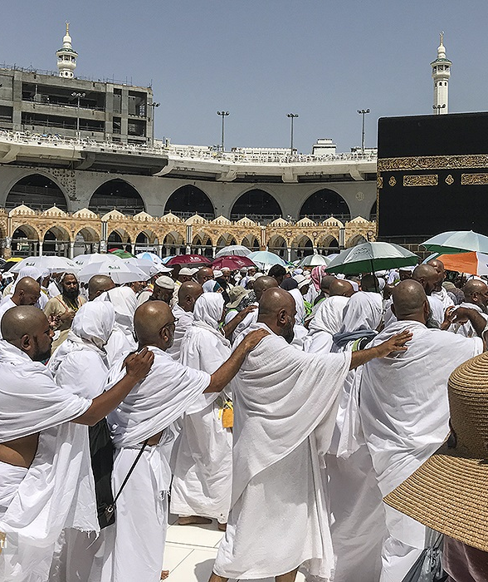
Performing Umrah: Tawaf
One will now begin Tawaf of the Ka’bah.
A male will walk briskly in the first three rounds; this is called Raml.
If it is not possible to walk briskly due to the crowds, or because one is having to look after family, you may walk at a normal pace.
A female will not do Raml.
Raml will only be performed in the first three rounds.
Raml and Idhtibaa’ will only take place in that Tawaf which has a Sa’ee after it.
In a Nafl Tawaf, one will not perform Raml or Idhtibaa’.
hajjnaseeha.com

Slide 23
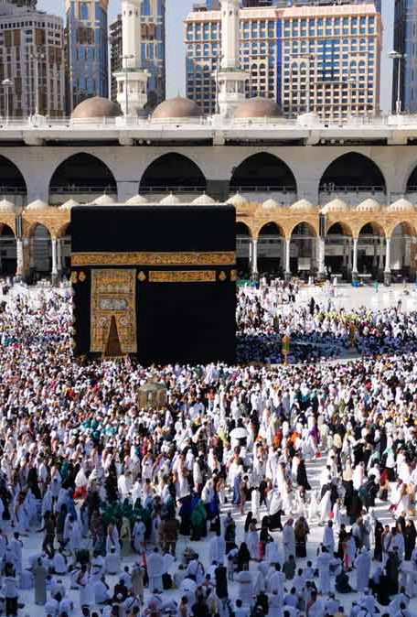
Performing Umrah:
Misc. Tawaf
One must walk around the Hateem and not cut through.
During Tawaf recite Qur’an, Zikr and make Du’a; avoid talking.
Do not read aloud in a manner which disturbs others.
It is disliked to eat; one may drink Zamzam in between if one feels thirsty.
Avoid copying the recitation of random groups/people.
hajjnaseeha.com

Slide 24
Performing Umrah: Misc. Tawaf
If one’s Wudhu breaks, a Fardh Salah starts or one needs to take a break, then it is permissible to pause the Tawaf and then continue from the very place he stopped.
One will not gesture to any other corner of the Ka’bah besides the corner with the Black Stone.
It is Mustahab to touch the Rukn al-Yamani (Yemeni corner) if it possible. If one cannot go near it due to the crowd, one should not gesture towards to it.
The Rukn al-Yamani should not be kissed.
hajjnaseeha.com

Slide 25
Performing Umrah: Completing Tawaf
The Tawaf is completed upon making Istilaam of Hajr al-Aswad at the end of the 7th round - this will be the 8th Istilaam in total.
It is Wajib to perform 2 Rak’ah after Tawaf.
The 2 Rak’ah should not be performed in the Makruh times for Salah.
These times are: After the Fajr prayer, at sunrise, at zenith, after the
Asr prayer and at sunset.
It is preferable to perform these 2 Rak’ah behind Maqam al-Ibrahim. However, if there is not enough space, one may perform these two Rak’ah anywhere.
hajjnaseeha.com

Slide 26
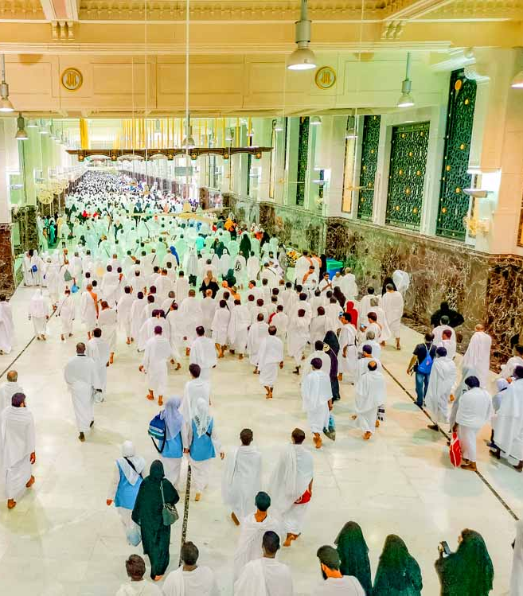
SA’EE

Slide 27
Performing Umrah: Preparing for Sa’ee
Sa’ee is to walk between the two hillocks of Safa and Marwa and is a Wajib element in Umrah. It is performed after the Tawaf.
Sa’ee is performed by walking between the two 7 times, starting at Safa and ending at Marwa.
The place where Sa’ee is carried out is called Mas’aa.
Practical tips:
Choose a less busy floor for Sa’ee.
You may wear your footwear if they are clean and perform Sa’ee.
hajjnaseeha.com

Slide 28
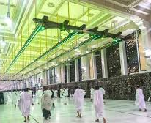
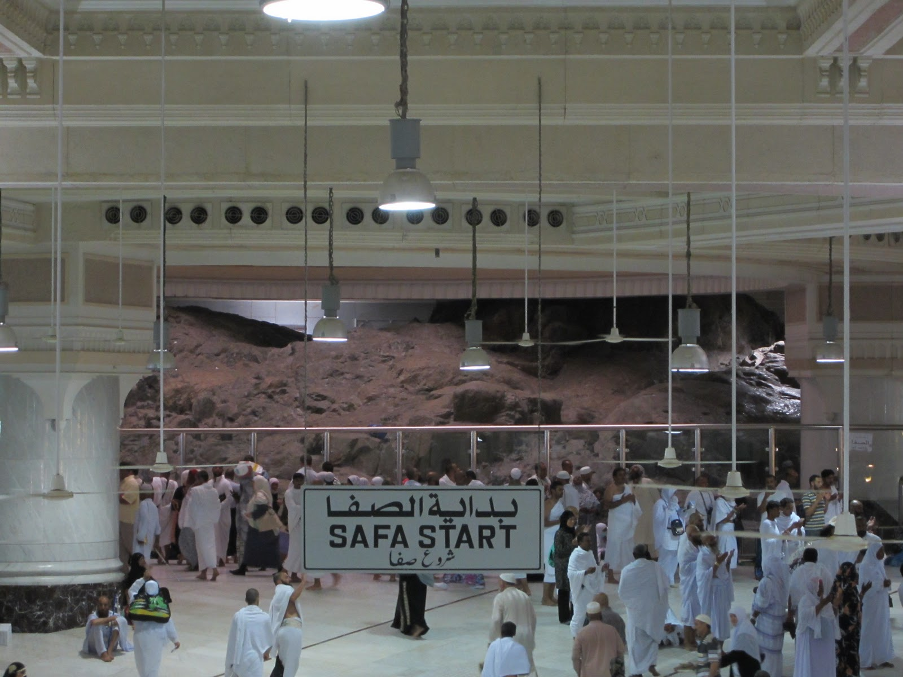
Performing Umrah:
Safa to Marwa
Start from Safa ensuring one is standing on the hillock.
Face the Qibla and say: ألله أكبر لا إله إلا الله
One should then make Du’a.
Now head towards Marwa.
Men should run from the start of the green light to its end.
Women will not run between green lights.
hajjnaseeha.com

Slide 29
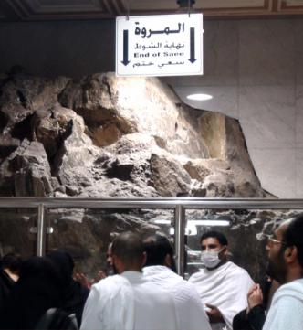
Performing Umrah: Marwa to Safa
One round is completed when a person reaches Marwa.
At Marwa, face towards the Qibla, say ألله أكبر لا إله إلا الله
and again make Du’a.
The 2nd round begins from Marwa.
Repeat this until you finish the 7th round, which will be at Marwa.
Finish with Du’a.
hajjnaseeha.com

Slide 30
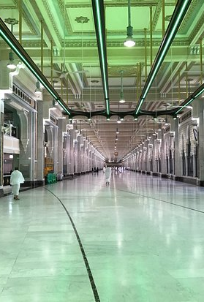
Performing Umrah:
Misc. Sa’ee
It is not necessary to have Wudhu when performing Sa’ee.
One should engage in Zikr and Du’a.
If Salah starts or one needs to take a break, it is permissible to continue from where one paused.
It is Mustahab to perform 2 Rak’ah in the Masjid after you complete the Sa’ee.
hajjnaseeha.com

Slide 31
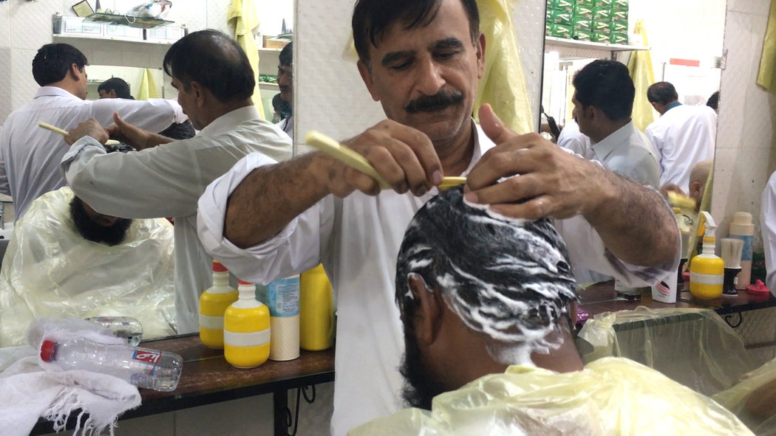
SHAVING AND TRIMMING

Slide 32
Performing Umrah: Shaving and trimming
Shaving or trimming all the hair on the head is Wajib for men to come out of Ihram.
Shaving is better than trimming.
It is permissible to cut one’s own hair or to go to the barbers.
Women must only trim an inch of her hair and no more. This can be done by herself.
Once a person cuts his/her hair, they are free from the laws of Ihram and the Umrah is complete.
Practical tips:
Ensure the barber uses a fresh blade (most of the time they do).
Women should cut their hair in the hotel room.
It is handy to keep a small pair of scissors.
hajjnaseeha.com

Slide 33
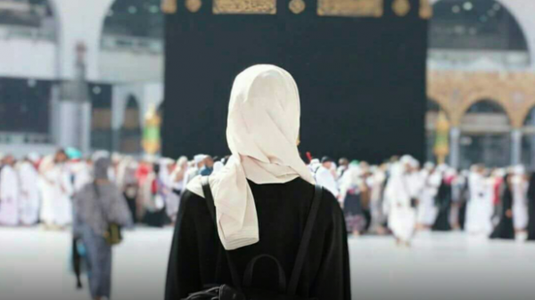
Tips and advice
for women

Slide 34
Entering into Ihram
A woman will not perform the 2 Rak’ah sunnah before Ihram if she is in her menses.
She will merely recite the Talbiyah and make Niyyah to come into the state of Ihram.
She can recite the Talbiyah and any Du’a in her menses.
She cannot recite the Qur’an, perform salah, enter the masjid or perform Tawaf in her menses.
hajjnaseeha.com

Slide 35
Umrah and menses
If a woman is experiencing her menses, she will not perform any Salah or Tawaf.
A woman will not enter Masjid al-Haram until after her menses are complete and she has taken a bath.
If a woman entered Ihram and she was experiencing her menses, then she will not perform the Umrah until after she becomes free of her menses.
She will have to remain in the state of Ihram until she performs Umrah.
hajjnaseeha.com

Slide 36
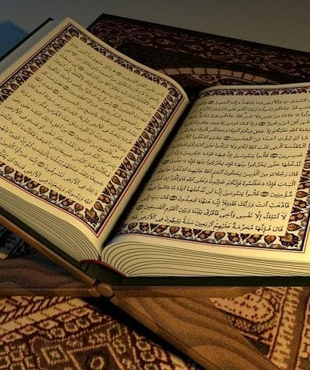
Acts of worship not permissible
Reciting Qur’an
Performing Salah
Making Tawaf
To enter the Haram (however, you can enter the Safa and Marwa area)
To enter Masajid (however, you can enter the Masjid compound)
hajjnaseeha.com

Slide 37
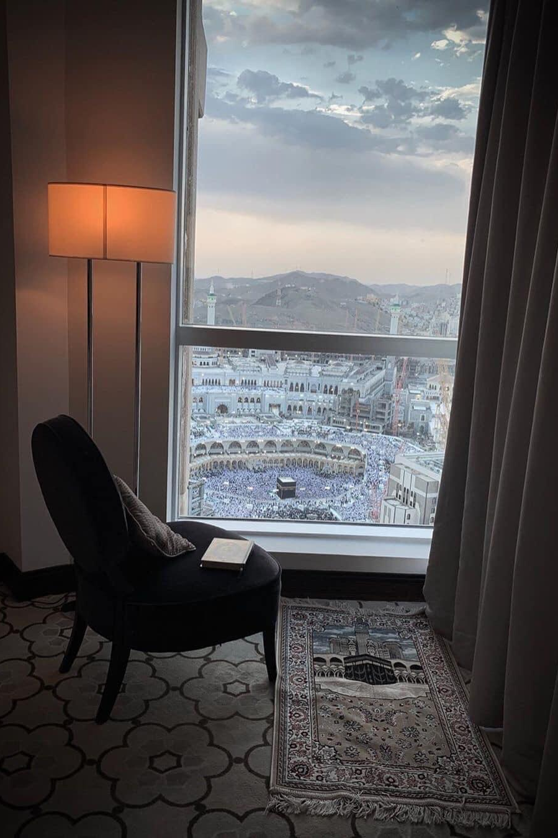
Acts of worship which are permissible
Doing Zikr, Istighfar (seeking forgiveness) and Talbiyah
Salawat upon Rasulullah
Du’a and reading Islamic books
Looking at the Ka'bah (from Safa and Marwa building, a hotel room/balcony etc.)
Treating people with kindness
Giving Sadaqah (charity)
hajjnaseeha.com

Slide 38
Taking the pill
The only Umrah ritual not permitted during menses is Tawaf; therefore this may lengthen the time you spend in Ihram.
If you think you will leave Saudi Arabia without having performed your Tawaf then it is permissible to take medication to delay the menses.
However, if your menses will finish whilst you are still in Makkah it is better not to take them.
Practical tips:
Contact your doctor and seek medical advice.
Pills often have side effects so read up on that beforehand.
Ask advice from sisters who may have used the pill during Umrah
hajjnaseeha.com | assubah.com

Slide 39
Umrah complete Alhamdulillah!
May Allah accept it from you, Aameen.
Please make Du’a for us!

Slide 40
